Slide 1

Notes:
Source: Oxford International Primary Computing Student Book 6, Unit 2, sections 2.3 Create a web page and 2.4 Add images to your web page, printed pages 26–29. Classroom adaptation using VS Code and basic HTML as requested. The book uses a website editor; these lessons retain its planning, structure, privacy, image relevance, permission, size and placement concepts. Generated visuals are illustrative examples.

Slide 2
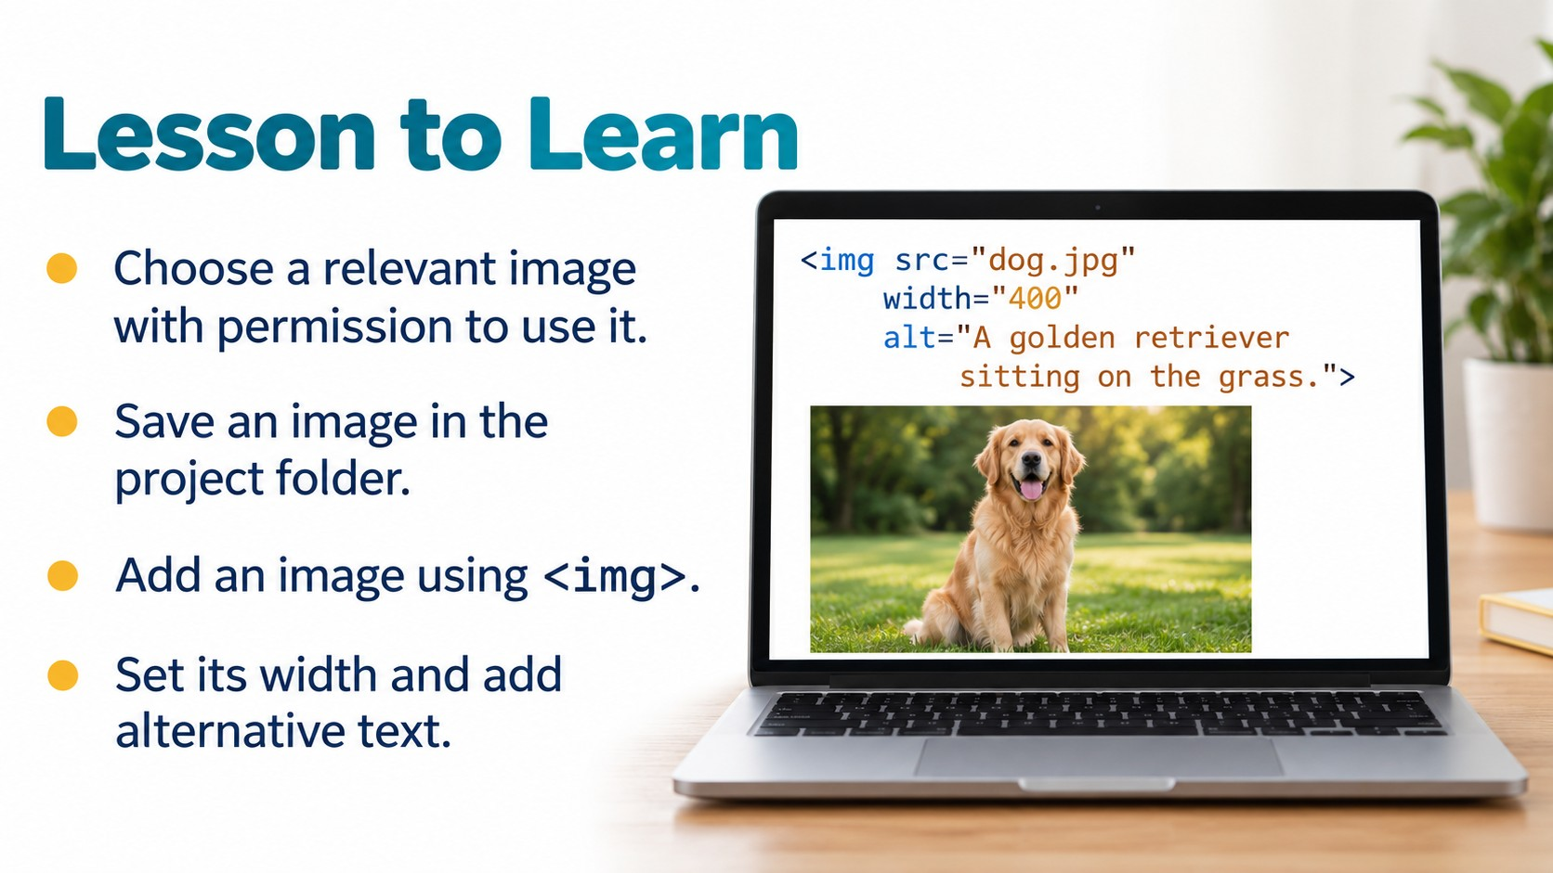
Notes:
Source: Oxford International Primary Computing Student Book 6, Unit 2, sections 2.3 Create a web page and 2.4 Add images to your web page, printed pages 26–29. Classroom adaptation using VS Code and basic HTML as requested. The book uses a website editor; these lessons retain its planning, structure, privacy, image relevance, permission, size and placement concepts. Generated visuals are illustrative examples.

Slide 3

Notes:
Source: Oxford International Primary Computing Student Book 6, Unit 2, sections 2.3 Create a web page and 2.4 Add images to your web page, printed pages 26–29. Classroom adaptation using VS Code and basic HTML as requested. The book uses a website editor; these lessons retain its planning, structure, privacy, image relevance, permission, size and placement concepts. Generated visuals are illustrative examples.

Slide 4

Notes:
Source: Oxford International Primary Computing Student Book 6, Unit 2, sections 2.3 Create a web page and 2.4 Add images to your web page, printed pages 26–29. Classroom adaptation using VS Code and basic HTML as requested. The book uses a website editor; these lessons retain its planning, structure, privacy, image relevance, permission, size and placement concepts. Generated visuals are illustrative examples.

Slide 5
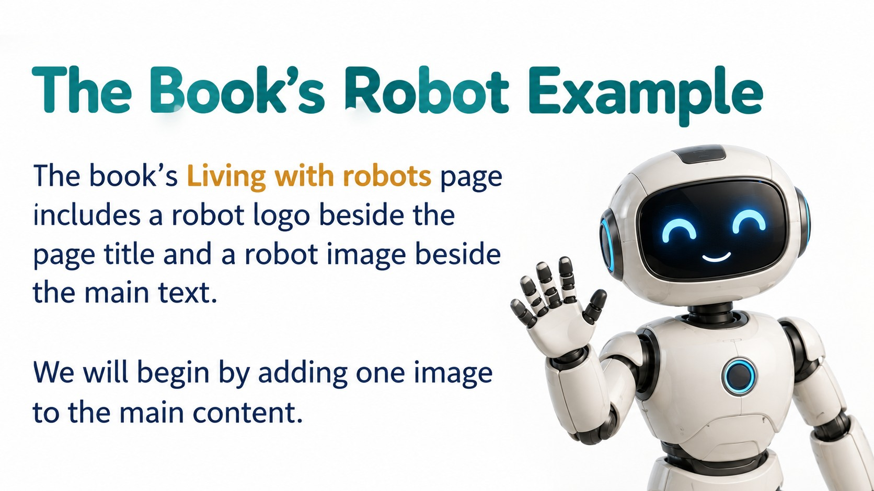
Notes:
Source: Oxford International Primary Computing Student Book 6, Unit 2, sections 2.3 Create a web page and 2.4 Add images to your web page, printed pages 26–29. Classroom adaptation using VS Code and basic HTML as requested. The book uses a website editor; these lessons retain its planning, structure, privacy, image relevance, permission, size and placement concepts. Generated visuals are illustrative examples.

Slide 6
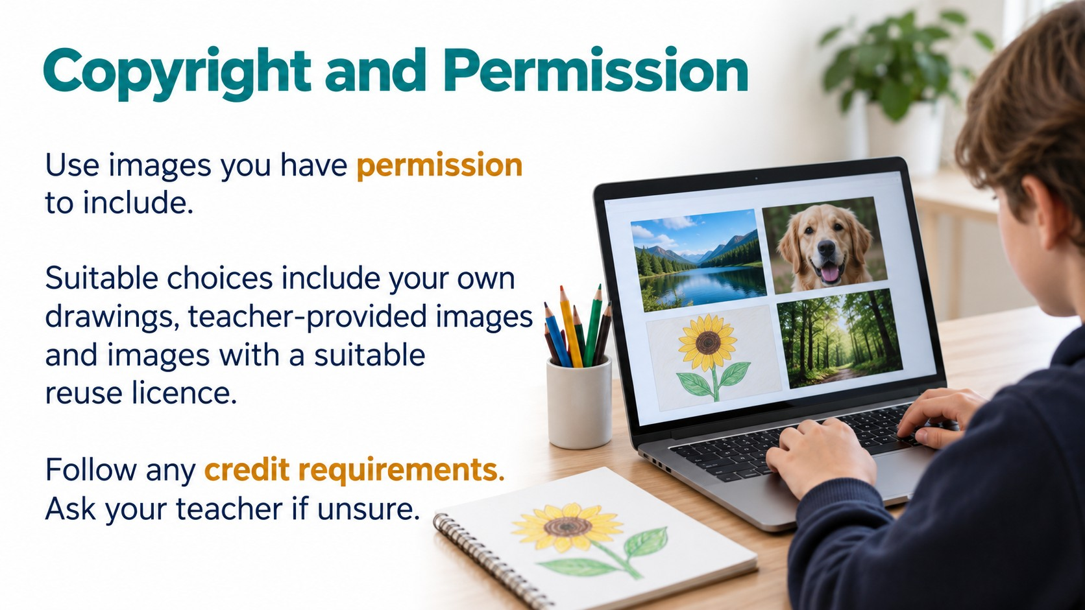
Notes:
Source: Oxford International Primary Computing Student Book 6, Unit 2, sections 2.3 Create a web page and 2.4 Add images to your web page, printed pages 26–29. Classroom adaptation using VS Code and basic HTML as requested. The book uses a website editor; these lessons retain its planning, structure, privacy, image relevance, permission, size and placement concepts. Generated visuals are illustrative examples.

Slide 7

Notes:
Source: Oxford International Primary Computing Student Book 6, Unit 2, sections 2.3 Create a web page and 2.4 Add images to your web page, printed pages 26–29. Classroom adaptation using VS Code and basic HTML as requested. The book uses a website editor; these lessons retain its planning, structure, privacy, image relevance, permission, size and placement concepts. Generated visuals are illustrative examples.

Slide 8
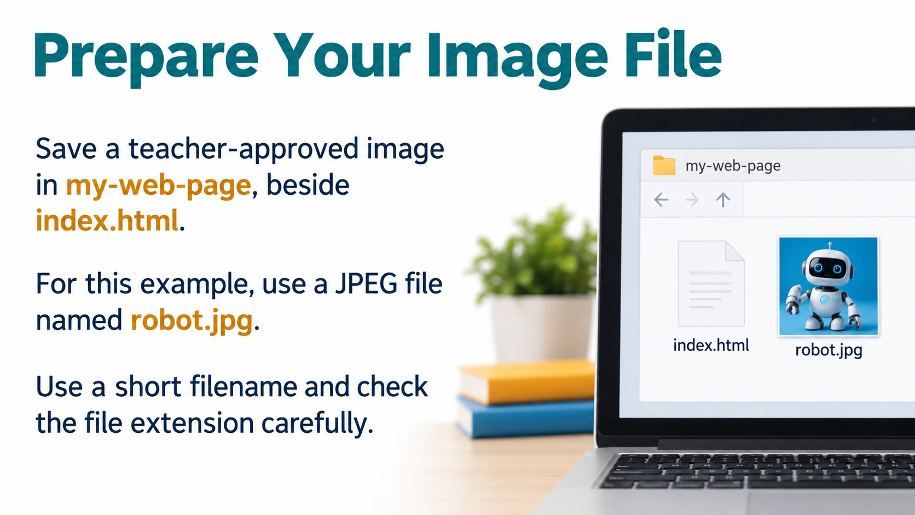
Notes:
Source: Oxford International Primary Computing Student Book 6, Unit 2, sections 2.3 Create a web page and 2.4 Add images to your web page, printed pages 26–29. Classroom adaptation using VS Code and basic HTML as requested. The book uses a website editor; these lessons retain its planning, structure, privacy, image relevance, permission, size and placement concepts. Generated visuals are illustrative examples.

Slide 9
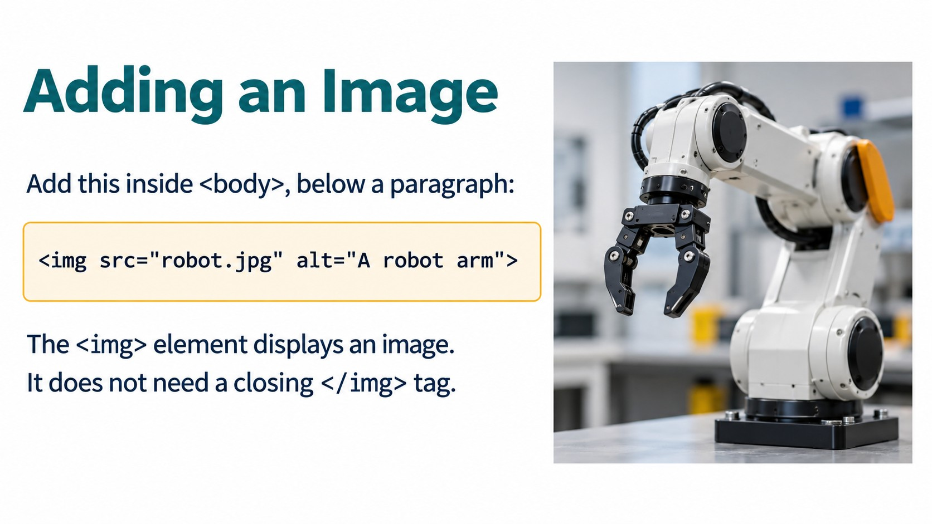
Notes:
Source: Oxford International Primary Computing Student Book 6, Unit 2, sections 2.3 Create a web page and 2.4 Add images to your web page, printed pages 26–29. Classroom adaptation using VS Code and basic HTML as requested. The book uses a website editor; these lessons retain its planning, structure, privacy, image relevance, permission, size and placement concepts. Generated visuals are illustrative examples.

Slide 10
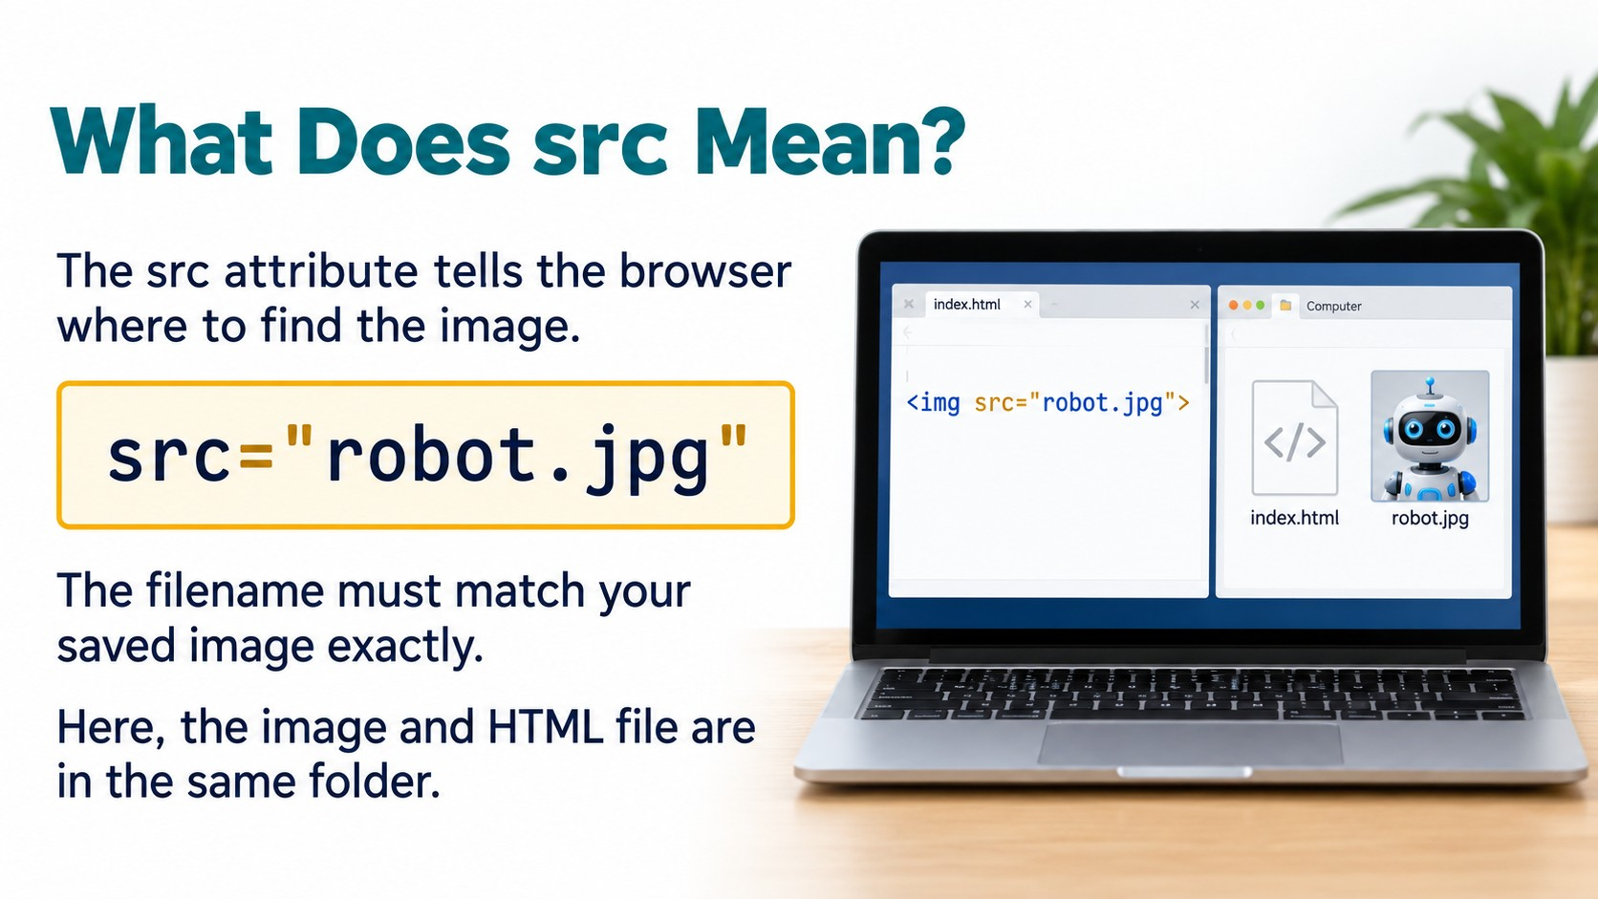
Notes:
Source: Oxford International Primary Computing Student Book 6, Unit 2, sections 2.3 Create a web page and 2.4 Add images to your web page, printed pages 26–29. Classroom adaptation using VS Code and basic HTML as requested. The book uses a website editor; these lessons retain its planning, structure, privacy, image relevance, permission, size and placement concepts. Generated visuals are illustrative examples.

Slide 11
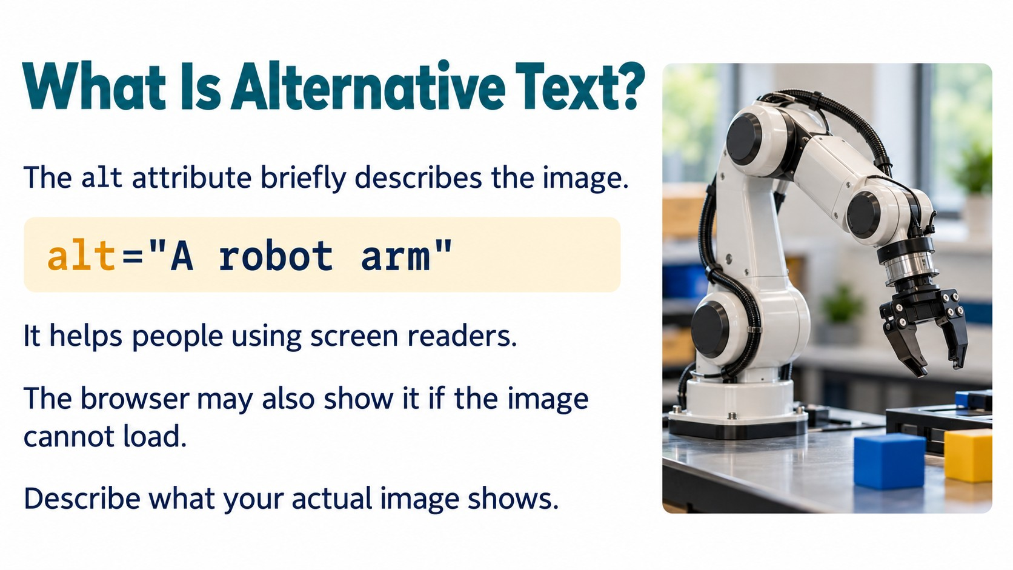
Notes:
Source: Oxford International Primary Computing Student Book 6, Unit 2, sections 2.3 Create a web page and 2.4 Add images to your web page, printed pages 26–29. Classroom adaptation using VS Code and basic HTML as requested. The book uses a website editor; these lessons retain its planning, structure, privacy, image relevance, permission, size and placement concepts. Generated visuals are illustrative examples.

Slide 12
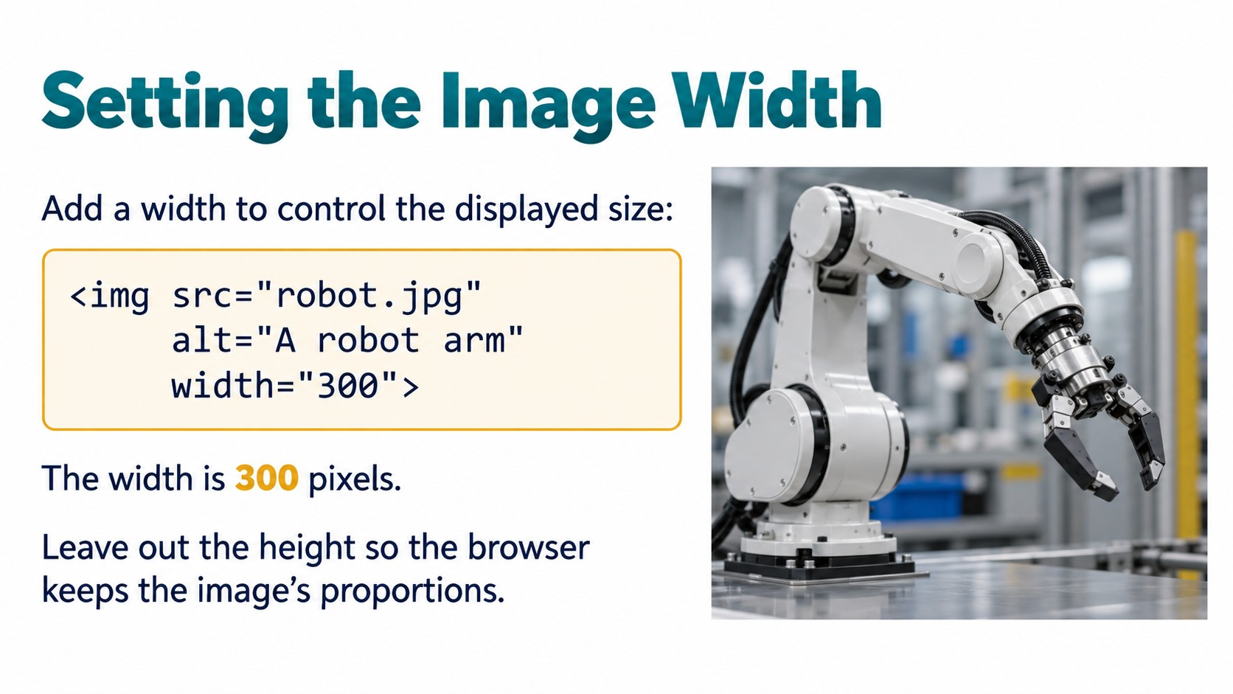
Notes:
Source: Oxford International Primary Computing Student Book 6, Unit 2, sections 2.3 Create a web page and 2.4 Add images to your web page, printed pages 26–29. Classroom adaptation using VS Code and basic HTML as requested. The book uses a website editor; these lessons retain its planning, structure, privacy, image relevance, permission, size and placement concepts. Generated visuals are illustrative examples.

Slide 13
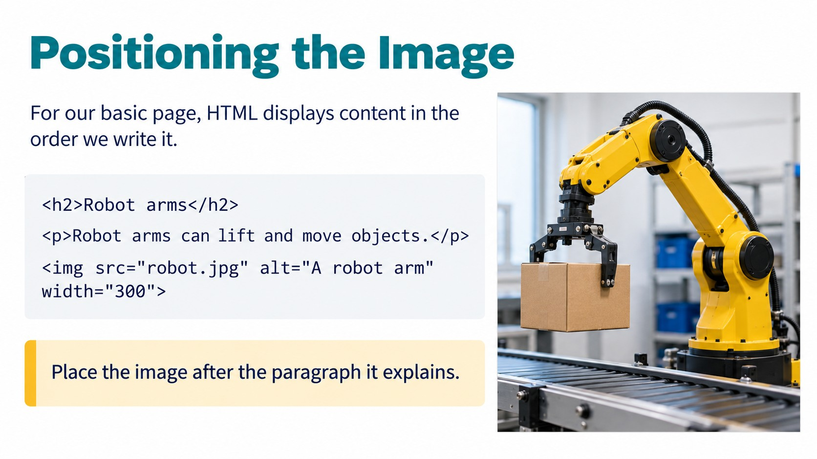
Notes:
Source: Oxford International Primary Computing Student Book 6, Unit 2, sections 2.3 Create a web page and 2.4 Add images to your web page, printed pages 26–29. Classroom adaptation using VS Code and basic HTML as requested. The book uses a website editor; these lessons retain its planning, structure, privacy, image relevance, permission, size and placement concepts. Generated visuals are illustrative examples.

Slide 14
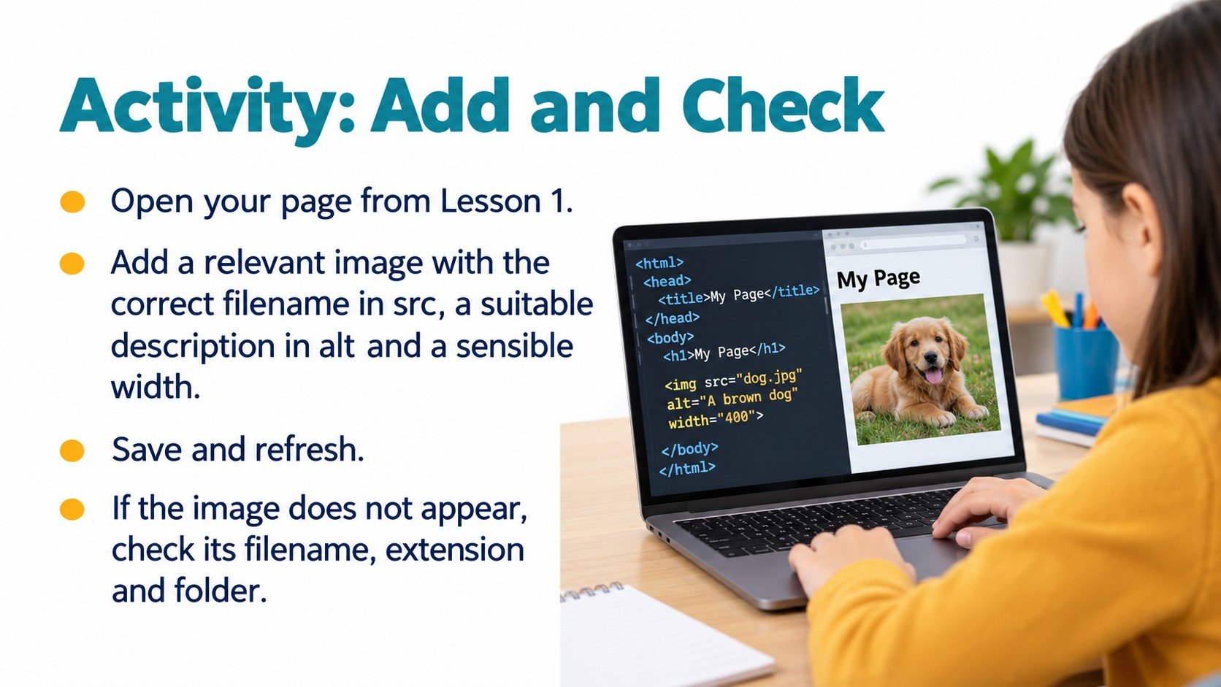
Notes:
Source: Oxford International Primary Computing Student Book 6, Unit 2, sections 2.3 Create a web page and 2.4 Add images to your web page, printed pages 26–29. Classroom adaptation using VS Code and basic HTML as requested. The book uses a website editor; these lessons retain its planning, structure, privacy, image relevance, permission, size and placement concepts. Generated visuals are illustrative examples.

Slide 15

Notes:
Source: Oxford International Primary Computing Student Book 6, Unit 2, sections 2.3 Create a web page and 2.4 Add images to your web page, printed pages 26–29. Classroom adaptation using VS Code and basic HTML as requested. The book uses a website editor; these lessons retain its planning, structure, privacy, image relevance, permission, size and placement concepts. Generated visuals are illustrative examples.

Slide 16
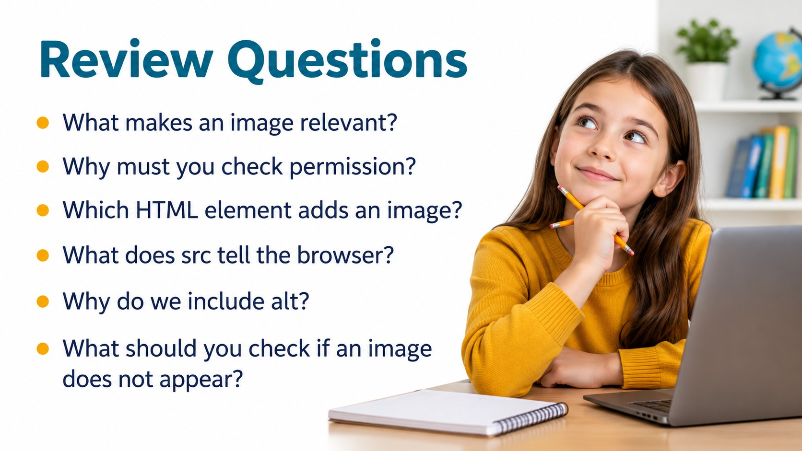
Notes:
Source: Oxford International Primary Computing Student Book 6, Unit 2, sections 2.3 Create a web page and 2.4 Add images to your web page, printed pages 26–29. Classroom adaptation using VS Code and basic HTML as requested. The book uses a website editor; these lessons retain its planning, structure, privacy, image relevance, permission, size and placement concepts. Generated visuals are illustrative examples.

